Slide 1
ACADEMIC WRITING IN ENGLISH:
CONCLUSIONS
Dr. Bret Zawilski, Assistant Professor of Rhetoric and Composition
Appalachian State University, Boone NC USA

Slide 2
Conclusions
Good writing requires a strong introduction and conclusion
Introduction
Creates an opening for your argument
Introduces your main topic
Demonstrates your stance on that topic
Conclusion
Summarizes your argument
Demonstrates what future research might be needed

Slide 3
Conclusions
A good conclusion should accomplish four things:
Make a final statement regarding your thesis or answer your focusing question
Summarize your main points or arguments
Highlight the significance of your topic
Forecast additional research that could be done on the topic
Be careful not to be too passionate about your topic or overstate claims.

Slide 4
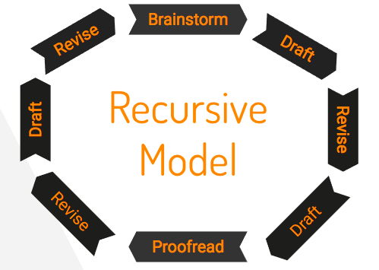
The Writing Process
Writing is a circular process
Revision is important
No paper is perfect; there is no mathematical formula for good writing

Slide 5
Invention
Gathering ideas is the first and most important part of writing:
You must generate ideas before you can write
You must become curious about the ideas you generate
Mindmapping, freewriting, and outlining can be used to generate ideas
You also should find a focusing question for your writing

Slide 6
Arrangement
Once you gather ideas, you need to organize them:
Organization will depend upon your audience and their expectations
You should consider how the evidence you provide fit together
Your organization should lead your audience toward a better understanding of your thesis statement

Slide 7
Process
Writing is a process:
Studying formal rules is no substitution for practicing your writing
Don’t worry about making errors when you first begin to write
Make use of revision and rewriting

Slide 8
ACADEMIC WRITING IN ENGLISH:
CONCLUSIONS
Dr. Bret Zawilski, Assistant Professor of Rhetoric and Composition
Appalachian State University, Boone NC USA

