Slide 1
Finding Quality Information for an Academic Paper
Allan Scherlen
Appalachian State University Library

Slide 2
Types of Sources to Support Your Paper
Books (Extended, broad treatment of the topic)
Scholarly Articles (in-depth treatment of part of the topic)
Magazine & Newspaper Articles (general, easy & current)
Primary Sources - (Data, testimony, images, artifacts)
(Examples: weather data, census data, public opinion polls, news photos)
Other Web Sources ( Organizations, institutes, governments)
Human Sources – (Interviews, social media, etc.)

Slide 3
The Process
Find your sources -- through good search strategy
Evaluate each source -- as you find it
Organize and study the most relevant sources
Integrate the source into your paper through:
Making notes on a copy of it (pre-writing),
Making separate notes about the source, and
working information from it into your outline.

Slide 4
Selecting Library Databases to find scholarly works
What kinds of sources will be best for your topic
and to what sources do you have access?
General Databases – Academic Search Complete Specialized Subject Databases - Environment Complete Books on the Environment Environmental Organization Websites

Slide 5
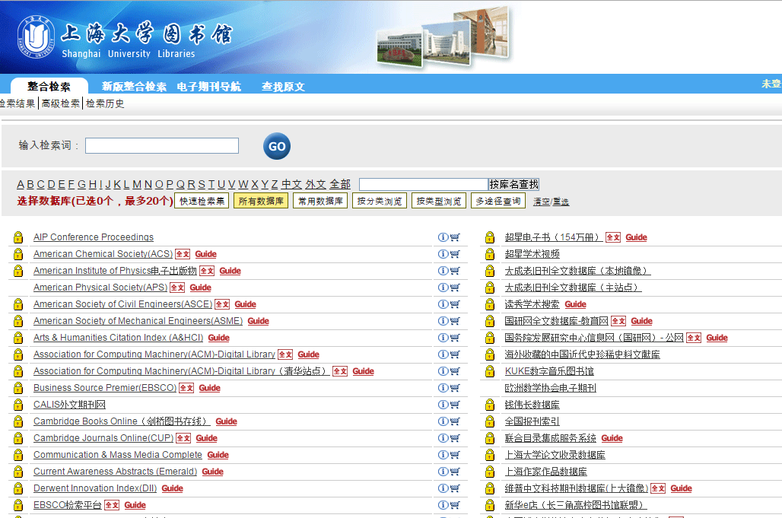
What sources will have info on your topic?
What databases do you have in your library?

Slide 6
Create search terms of your topic
Example Topic: Converting to alternative energy sources can reduce global warming
Search Terms: Global warming and alternative energy

Slide 7
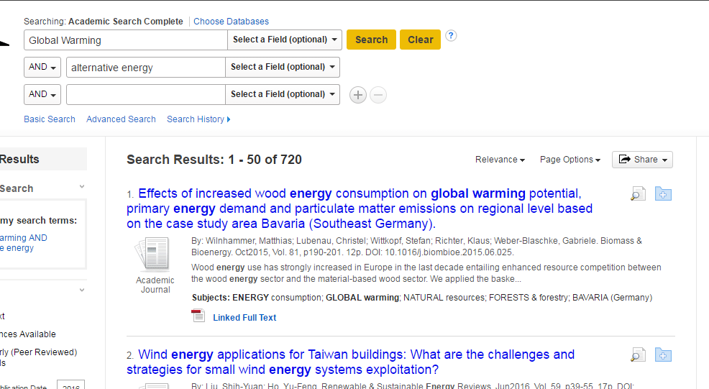
First do a KEYWORD search and examine results for other words or additional words to search

Slide 8
Adding search terms to your search
Adding Search Words:
Global warming and alternative energy and wind
Adding and Removing More Words:
Global warming and energy and wind and China

Slide 9
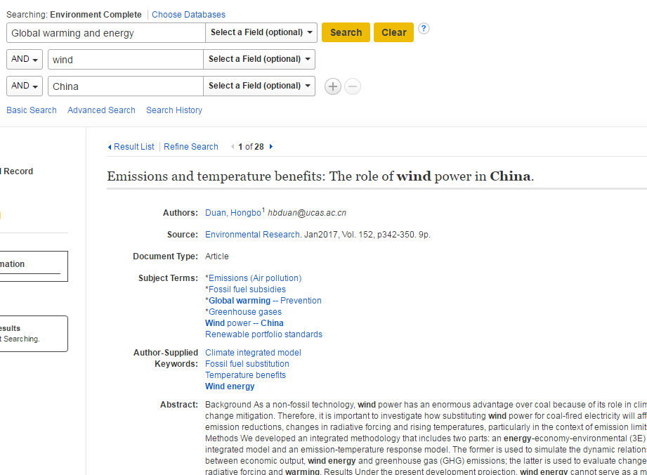
Refined search:
Global warming and energy and wind and China

Slide 10
Duan, H. (2017). Emissions and temperature benefits: The role of wind power in China. Environmental Research, 152342-350.
Follow links in database
to the article

Slide 11
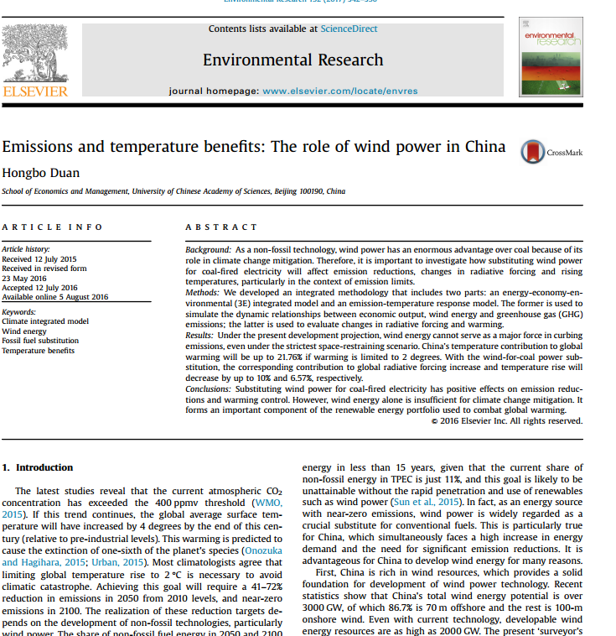
Follow links in the database
to the article –
Read the article

Slide 12
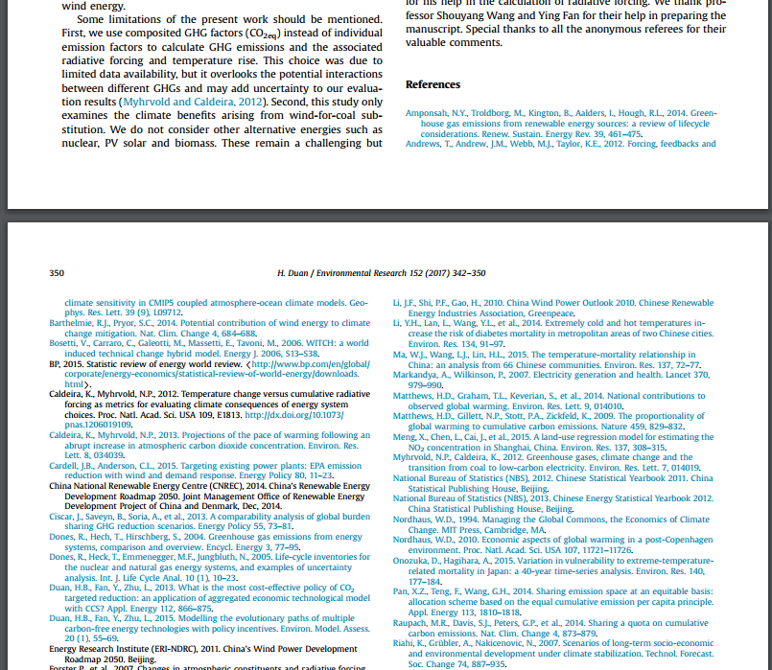
And examine
the list of works cited
at the end
of the article

